Slide 1
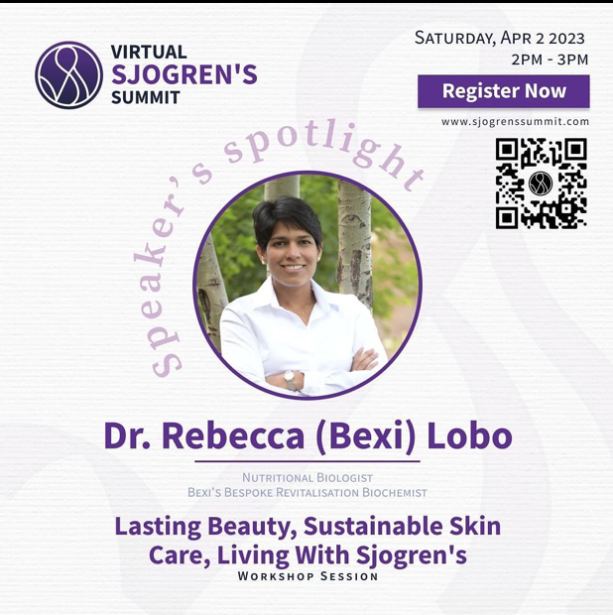
Nutritional Biologist & Biochemist
Bexi’s Bespoke Revitalisation

Slide 3
The Story Of My Success
(Not in chronological order of events.)
Bexi & Bexi’s Bespoke Revitalisation
Skin health & function
Costs of living with Sjogren’s
Barriers to healthy skin care
My approach to skin care
Whole foods, your skin, & skin microbes

Slide 4
Bexi (Rebecca Lobo, PhD)
BS in Chemistry
PhD in Nutritional Biology (nutrient metabolism and cancer)
Living with Sjogren’s (SHOW-grins)
Weepy, painfully dry, hypersensitive skin, atopic eczema, contact dermatitis
Formulated skincare solutions from whole foods and essential oils to improve skin health and function

Slide 5
Undiagnosed Sjogren’s & A Career Pivot
My skin was so sensitive I could no longer work in a lab; I couldn’t be exposed to chemicals and mice (and a lot else).
My fatigue was so severe I could no longer work any 9-5 job.
I required a flexible work schedule to accommodate my health needs.
I always wanted to own a business.
I founded Bexi’s before I was diagnosed with Sjogren’s.

Slide 6
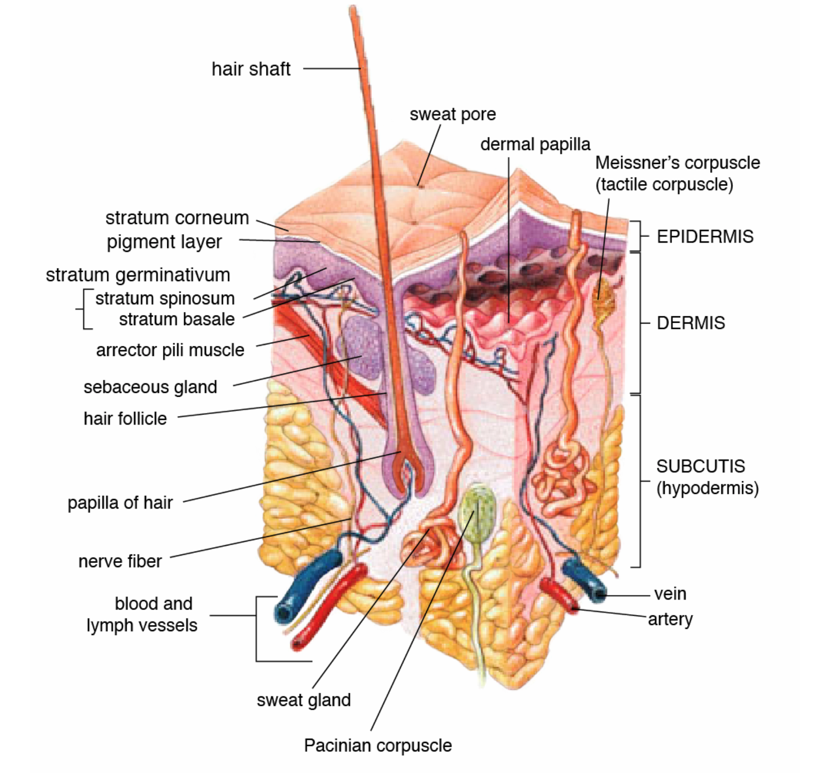
Your Skin Is Your Largest Organ
US-Gov, Public domain, via Wikimedia Commons
16% of body mass
If you weigh 150 lbs, 24 lbs is skin.
If most of your skin is inflamed a significant portion of your body is inflamed...
Bexi (Rebecca Lobo, PhD)

Slide 7
Your Skin Is Dynamic & Responsive
US-Gov, Public domain, via Wikimedia Commons
Skin contains lots of nerves and blood vessels.
What you put on your skin ends up in your body because you have so many blood vessels so close to your skin surface.
Bexi (Rebecca Lobo, PhD)

Slide 8
Your Skin Is Multifunctional
Creates Your Unique Identity
Distinguishes, separates and protects you from your surroundings
Outward expression of who you are
Gives you color and shape
Regulates and Maintains Your Metabolism
Makes vitamin D
Stores water and nutrients (fat, sodium, vitamin D)
Facilitates excretion of waste materials (sweat)
Regulates body temperature
Senses Your Environment
Receptors for temperature, pressure, touch, and pain
Protects You
Protects and holds your internal tissues and organs
Protects your body from microbes (bacteria, viruses)
Protects against abrupt changes in temperature
Protects against UV light and sunburn
Prevents dehydration

Slide 9
Bexi Sez...
Your skin is:
The largest organ in your body
Dynamic and responsive
Multifunctional
Skin care IS health care.

Slide 10
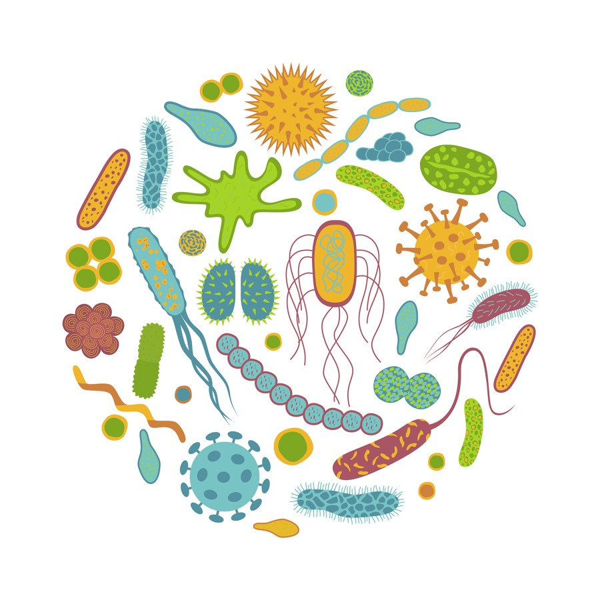
Your Skin Is The Interface Between You & Nature
US-Gov, Public domain, via Wikimedia Commons
You house multiple ecosystems
of microbes on and in your body, one of the biggest is on your skin, your skin microbiome.

Slide 11
You Are In A Relationship With The Microbes Living On & In Your Body.
What you put on and in your body
(skincare, makeup, food, drink, drugs)
Types of microbes and
byproducts of their metabolism
You influence their health; they influence yours.
Your microbiomes are part of your body’s defense systems.

Slide 12
Microbes Feed On Sebum, Your Skin’s Natural Moisturizer.
Sebum is an oily, waxy substance produced by sebaceous glands in your skin.
Sebaceous glands are often dysfunctional.
Overproduction of sebum results in oily skin and acne.
Underproduction of sebum (like in Sjogren’s) results in dry skin.
Like mucus elsewhere, sebum is part of your barriers and defenses.

Slide 13
Barrier Function
US-Gov, Public domain, via Wikimedia Commons
Epithelial Cells
Bexi (Rebecca Lobo, PhD)

Slide 14
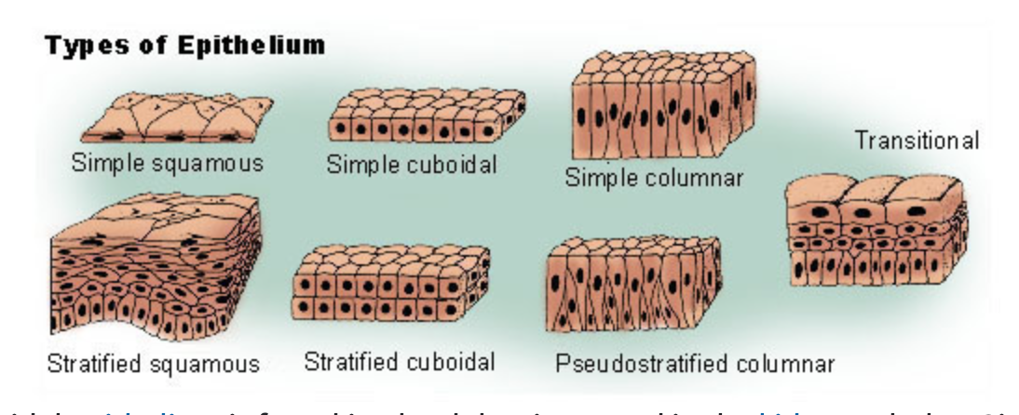
Epithelial Cells & Barrier Function
https://training.seer.cancer.gov/images/anatomy/cells_tissues_membranes/epithelium_tissue.jpg
Notes:
Epithelial cells come in lots of shapes and sizes but they have the same function. But they
Every surface where the outside comes in contact with our insides is covered in epithelial cells. The food is inside your body but it’s not outside of you. Microbes eat food. And are

Slide 15
You Are In A Relationship With The Microbes Living On & In Your Body.
What you put on and in your body
(skincare, makeup, food, drink, drugs)
Types of microbes and
byproducts of their metabolism
You influence their health; they influence yours.
Your microbiomes are part of your body’s defense systems.

Slide 16
Defenses Of Healthy Skin
OUTSIDE YOUR BODY
INSIDE YOUR BODY
4. Immune system
Microbes
Sebum
Skin
Nutrients
Nutrients
Pollen
Selective, functional communication between the outside and inside

Slide 17
Dry Skin Provides Poor Barrier Protection & Defense
OUTSIDE YOUR BODY
INSIDE YOUR BODY
Dysfunctional microbiome
Low / no sebum
Dysfunctional skin
4. Immune system
Nutrients
Nutrients
Pollen
Pollen
Leaky barriers lead to chronic inflammation & hypersensitivity to the environment.

Slide 18
Bexi Sez...
Epithelial cells make up the top layer of all the openings to your body (e.g., gut and skin) and provide a selectively permeable barrier.
Your epithelial cells, skin microbes, sebum, and immune system make up your skin’s barriers and defenses. You are in a relationship with the microbes living on & in your body.
What you put on your body affects the health of your skin and skin microbiome.

Slide 19
The Burdens of Sjogren’s
Dysfunctional Barriers And Defenses
Nerve Dysfunction
Dryness
Fatigue

Slide 20
Dry Skin Increases Your Stress Load
Dry skin
Environment triggers immune responses
Immune dysfunction
Chronic inflammation & hypersensitivity to the environment

Slide 21
Living With Sjogren’s Is Expensive
The cost of inflammation:
Money (special food, clothing, skincare, travel accommodations)
Time (required self-care, doctors’ appointments)
Energy (required self-care, revved up immune system, pain level, dehydration)
Management strategies:
Decrease stress
Strengthen barriers and defense
Notes:
Give examples from your life

Slide 22
Stress, You Need Some, But, Not Too Much
Disease e.g., Sjogren’s
Your Health
Stress

Slide 23
Allostatic Load
The cumulative burden of chronic stress (your daily habits) and life events on your body
Disease e.g., Sjogren’s
Your Health
Allostatic load

Slide 24
Types Of Daily Stress That Add To Your Allostatic Load
Your relationships
Your interactions with people
What you think and say
What you do
What you breathe
What you eat and drink
What you put on your skin
10 - Inflammation
0 – No Inflammation
Notes:
Your body is designed to thrive with certain levels of stress,
but, like food and almost anything else,
too little and too much are harmful.
Setting boundaries

Slide 25
Sjogren’s Decreases Your Capacity For Stress Tolerance
FLARE
No Sjogren’s
Sjogren’s
Notes:
Your body is designed to thrive with certain levels of stress,
but, like food and almost anything else,
too little and too much are harmful.

Slide 26
Your Skin Care Choices Increase Or Decrease Your Allostatic Load
Skincare products containing harmful ingredients, e.g., fragrance, phthalates, & parabens
Skincare products made with whole foods
Simple skin care routine
Anti-aging products, e.g., peptides
Lightening products
Drugs masquerading as nutrients

Slide 27
Bexi Sez...
Living with Sjogren’s is expensive (time, money, energy).
Manage Sjogren’s by decreasing stress and strengthening barriers and defenses.
Your skincare choices can increase or decrease your allostatic load.
Feed your skin whole foods from the outside in and within.

Slide 28
Barriers To Healthy Skin Care In The US
Little oversight and regulation
Definition of drug vs. cosmetic
Industry focus on profits over people
Industry focus on the illusion of skin health (look and feel) rather than actual health (function)
Misleading marketing & blatant misinformation

Slide 29
Regulation Of The Skincare Industry
What oversight and regulation?
The skincare industry operates on the honor (LOL) system.
There are multiple loopholes in the laws governing skincare.
In the US, anyone can put anything in a jar and legally sell it as skincare.

Slide 30
Drug Or Cosmetic?
Definitions are based on intended use rather than the actual effect of the product on your body and health
Drugs are, "articles (other than food) intended to affect the structure or any function of the body”.
Cosmetics are, "articles intended to be rubbed, poured, sprinkled, or sprayed on, introduced into, or otherwise applied to the human body...for cleansing, beautifying, promoting attractiveness, or altering the appearance”
Loophole in the law...

Slide 31
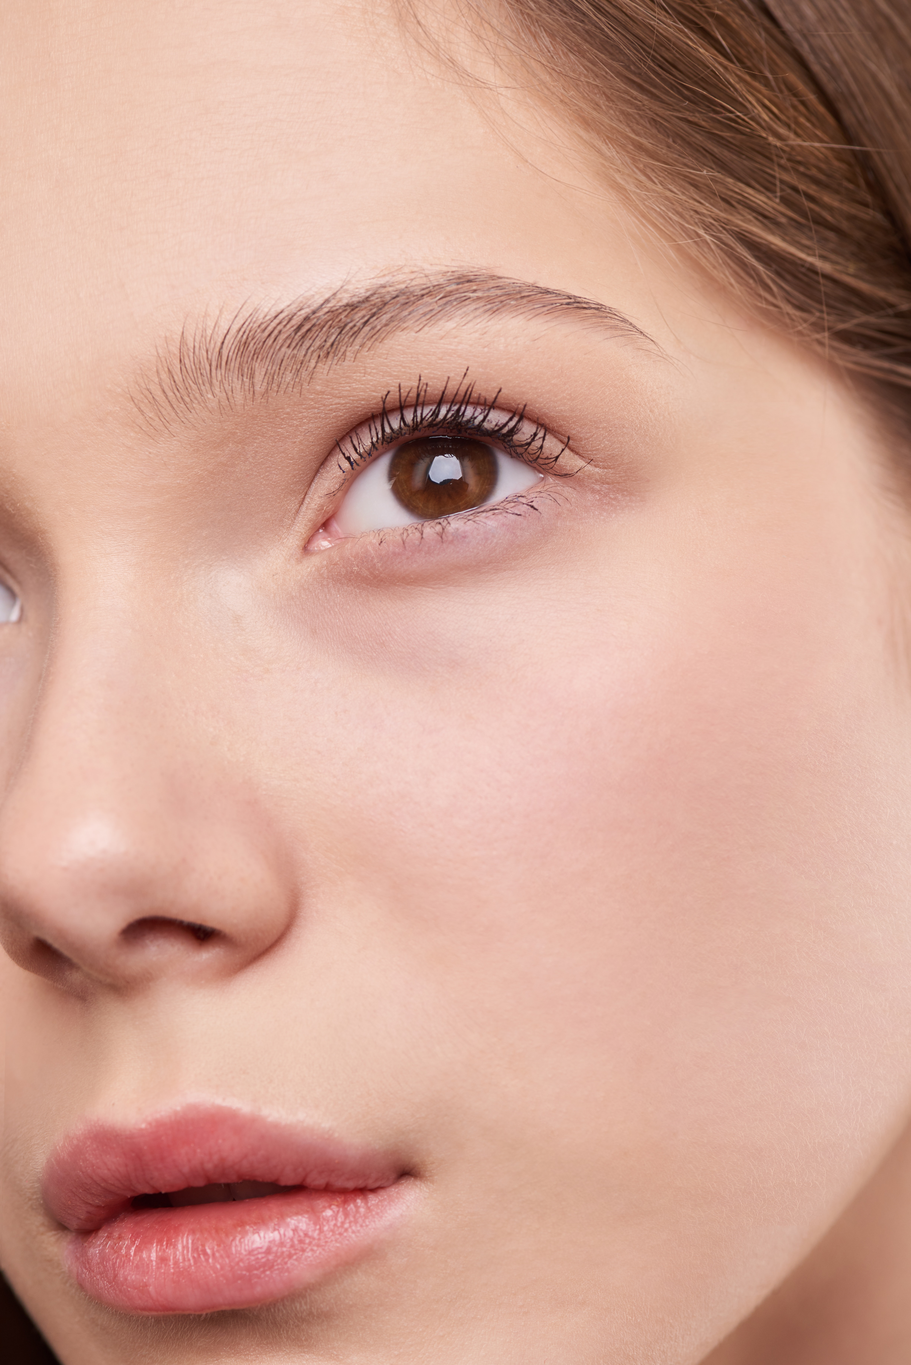
Beauty: How It’s Defined
”Young and flawless-looking”
Promoting an illusion of skin health.
Look and feel are emphasized.
Skin function is ignored.
Notes:
The industry is preying on your vanity and your pocket book and they’re not focused on the health of your skin. And that’s important, as the largest organ in your body, the health of your skin is important to your entire body’s health.

Slide 32
“Young & Flawless-looking”, An Unrealistic Definition Of Beauty.
Aging is inevitable & natural.
Going against aging is going against your biology.
You’re starting a war against yourself, anti-self, auto-immune.

Slide 33
“Young & Flawless-looking” Does Not Benefit You.
It creates insecurity and cycles of addiction and disconnection.
For example, using anti-aging creams to remove wrinkles.

Slide 34
“Young & Flawless-looking” Pits You Against You.
Sjogren’s is you attacking you.
Management of Sjogren’s requires forming habits to help you stop attacking yourself.
How much does it help to attack yourself with your thoughts and skincare products?

Slide 35
Bexi Sez...
Anyone can put anything in a jar and legally sell it as skincare. (US)
“Young and flawless-looking” is an unsustainable and destructive definition of beauty.
Invest your time, money, and energy in skin care that supports you and your long-term health.
Strive for lasting beauty, beauty that is functional and endures at every age.
Beautiful skin is healthy, functional skin.

Slide 36
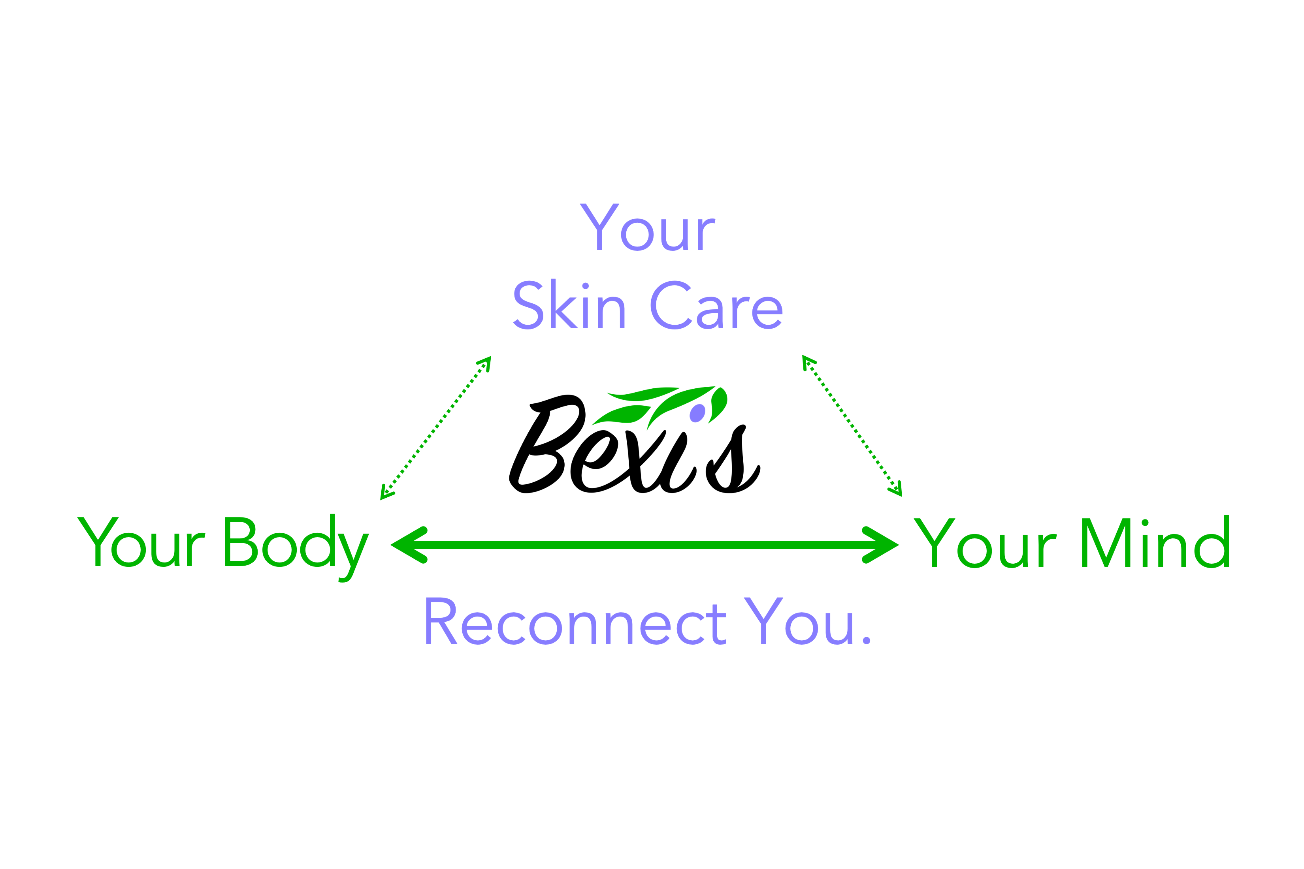
A Different Approach To Skin Care
Does your skincare product / ritual / habit support long-term health?

Slide 37
Your Body Is Self-Healing... If Given The Right Components.
Whole foods, water & hydration
Connection (with yourself, others, & Nature)
Self-acceptance / love
Time / Patience
Mindfulness
Some drugs
Movement
Massage
Rest

Slide 38
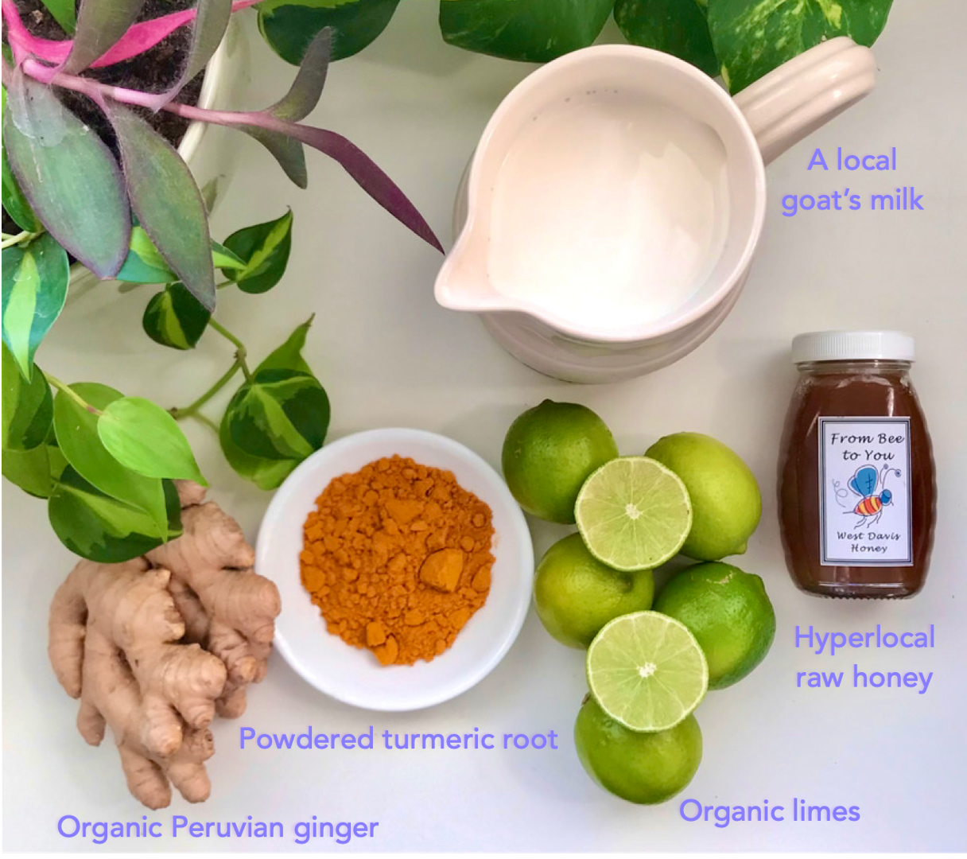
Whole Foods (NOT The Grocery Store): Minimally Processed Food
Animal milk (cows, sheep, goats) is a whole food.
“Milk” from nuts, seeds, and grains are NOT whole foods because they are made by processing whole foods.

Slide 39
Whole Foods (NOT The Grocery Store): Feed Your Skin From The Outside In & Within
Whole foods give your skin and your skin microbiome the building blocks it need for it to repair itself and grow.
Building blocks are nutrients in easily recognizable forms, concentrations, and structures.

Slide 40
Your Microbiome Thrives On Whole Foods (NOT the grocery store)
US-Gov, Public domain, via Wikimedia Commons
Bexi (Rebecca Lobo, PhD)

Slide 41
Effects Of Skincare Ingredients On Your Skin & Skin Microbiome?
Product A
water, mineral oil, isopropyl palmitate, sorbitol, propylene glycol, polyglyceryl-3 diiosstearate, polyglyceryl-4 diisostearate-polyhydroxystearate-sebacate, cetyl palmitate, magnesium sulfate, aluminum stearates, phenoxyethanol, lanolin alcohol, sodium citrate, citric acid, potassium
Product B
goat’s milk, macadamia nut oil, honey, lactobacillus ferment, coconut oil, elderberry fruit (sambucus nigra) extract, beeswax, aloe vera powder, guar gum

Slide 42
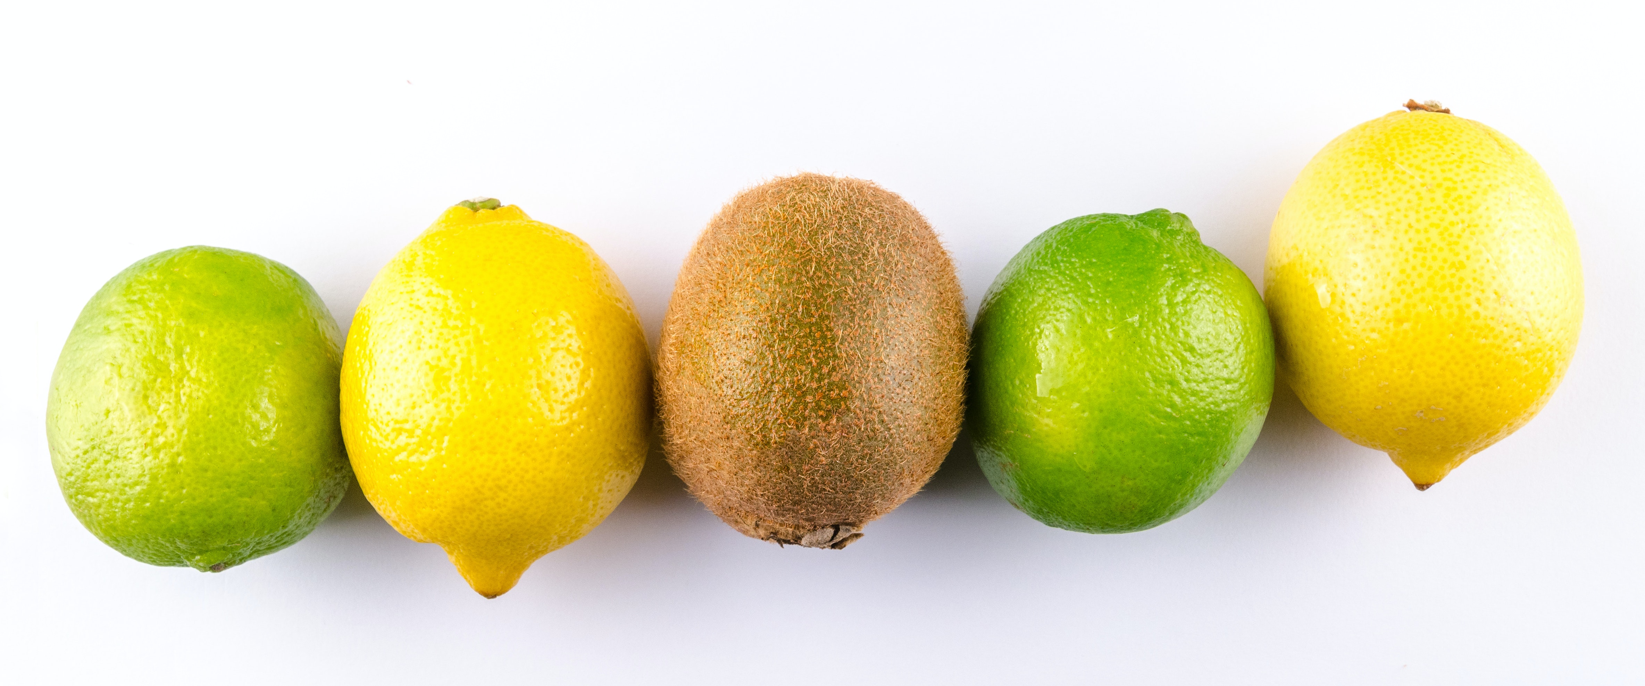
Whole Foods (NOT the Grocery Store): Feed Your Skin From The Outside In
Instead of using a synthetic vitamin C serum, rub a slice of lemon, lime, or kiwi on your skin.

Slide 43
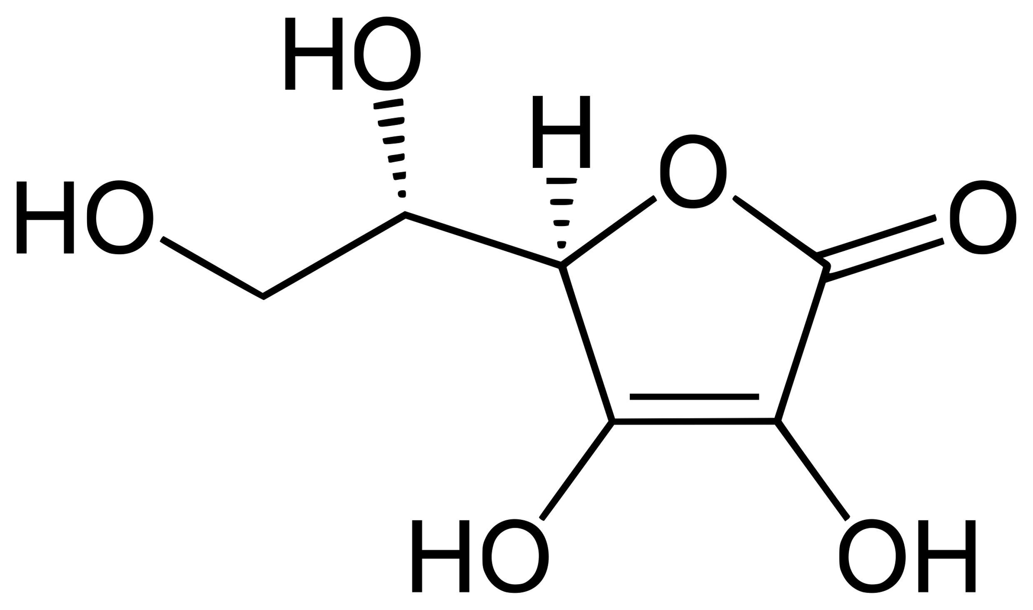
Isolated, Synthetic Nutrients Can Be Drugs
Ascorbic Acid (Vitamin C)
“Vitamin C is a potent antioxidant drug that can be used topically in dermatology to treat and prevent changes associated with photoageing.”
Indian Dermatol Online J. 2013 Apr-Jun; 4(2): 143–146.

Slide 44
The Entourage Effect In Whole Foods
Your body recognizes this form easily
Vitamin C in whole foods comes already stabilized and supported by an entourage of other molecules
Synthetic vitamin C needs to be stabilized artificially

Slide 45
Peptides Are FDA-Unapproved Drugs
Peptides are protein fragments that are functionally active in your body.
Peptides, especially neuropeptides are primarily found in anti-aging skincare products, but they also can be found in makeup.
Neuropeptides regulate your physiology, specifically neural activity.
Notes:
Dependent on product that gives you an illusion of beauty and health.

Slide 46
What Are The Long-term Effects Of Peptides On Your Health?
Nobody knows...There are no studies and no data.
Notes:
Unintended consequences, talcum powder causing ovarian cancer

Slide 47
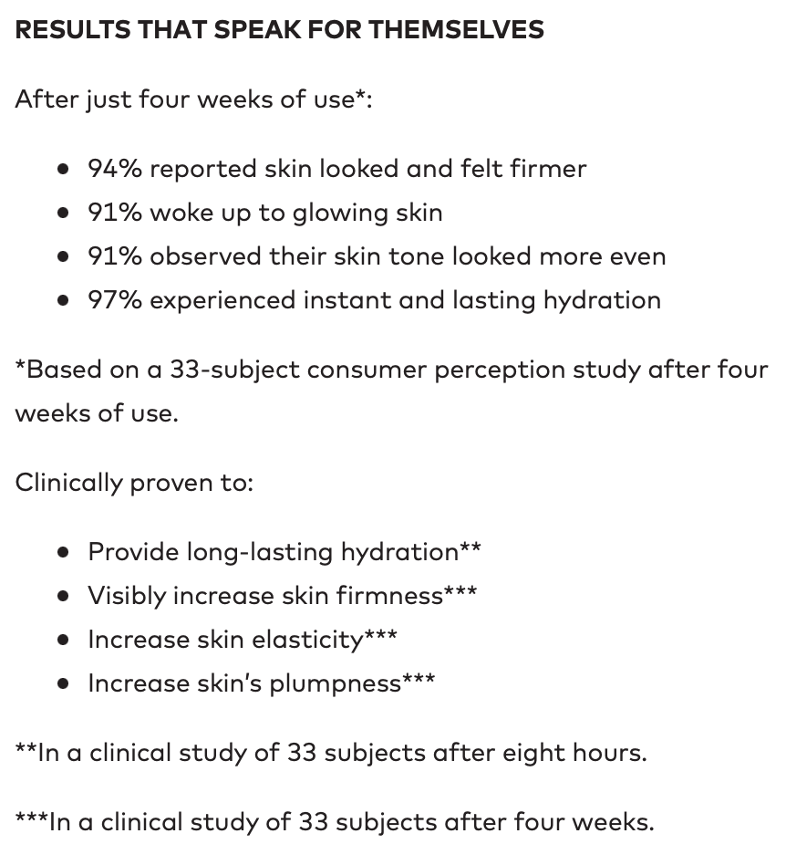
Clinical Trials
Subjective Measurements
Small sample size
Short trials (hours / weeks)

Slide 48
Bexi Sez...
Beautiful skin is functional skin.
Skin care IS health care.
Feed your skin and skin microbes whole foods from the outside in.
Reconnect with you.

Slide 49
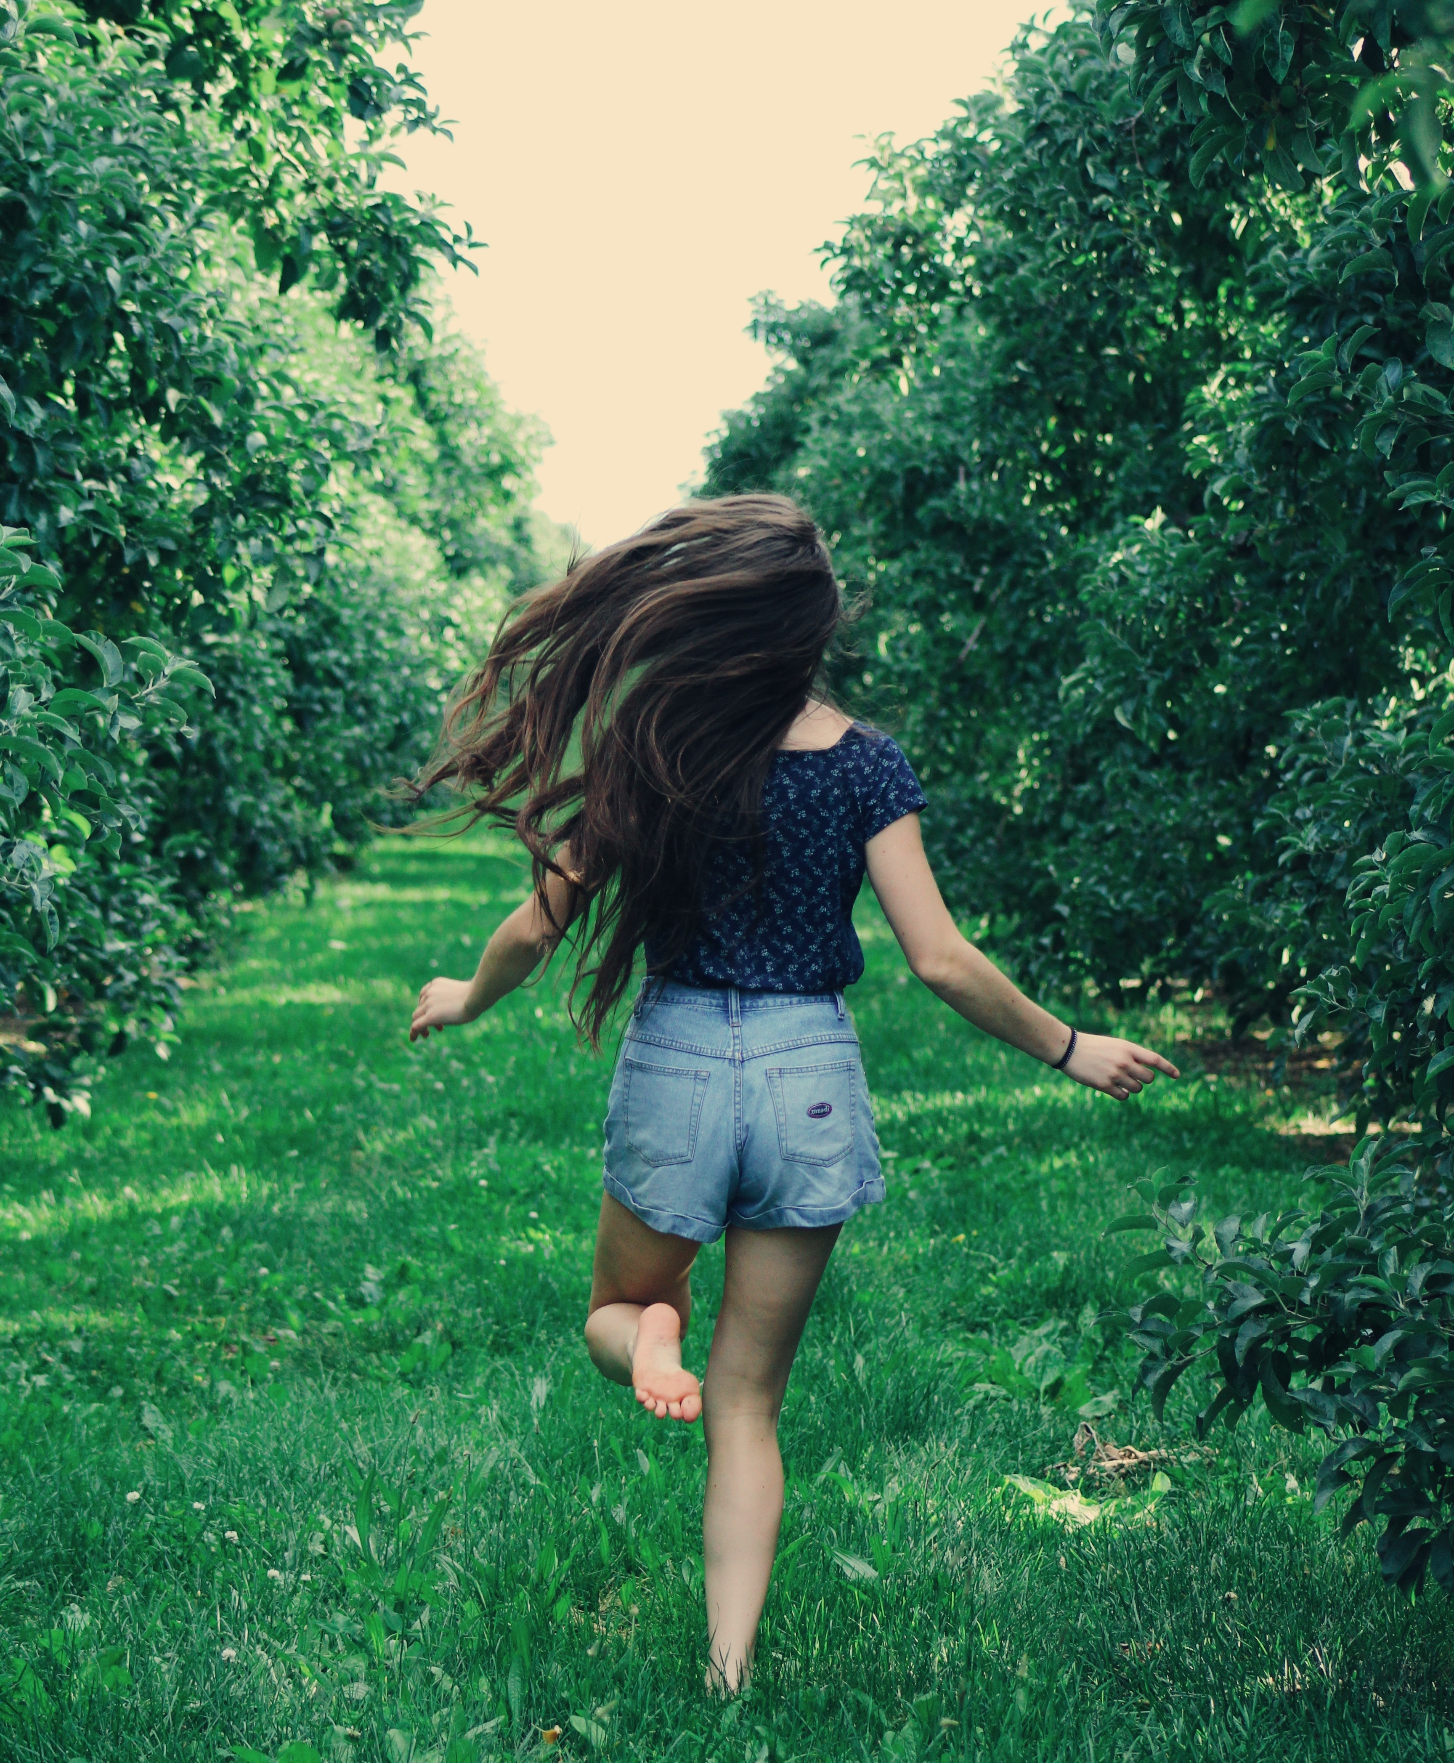
Feed Your Skin Whole Foods (Again...)
Save money, time, and energy.
Save Mother Nature.
Improve your health.
Free You; Be You.

Slide 50
Effects Of Using Whole Foods (...) As Skincare
17 days
2 years
Before Bexi’s
After Bexi’s
Revitalisation (Year 1) - $3,594 ($300/month)
Maintenance (Year 2) - $1,355 ($113/month)
Notes:
Mention hair

Slide 51
Effects Of Using Whole Foods (...) As Skincare
17 days
2 years
Before Bexi’s
After Bexi’s
“Within a couple of months I could see how much more resilient my skin was becoming. Prior to this, I was trying so many products that were one extreme or the other. They were prescription strength pharmaceuticals and, therefore, contributing to the imbalances in my body, or, ‘natural’ products that literally had no effect. ”

Slide 52
Before: Restrictive & Expensive
Costs:
Time
Money
Energy
Comfort
Choices
Spontaneity
You’re trapped in a shrinking life.

Slide 53
After: Freeing
Saves:
Time
Money
Energy
You buy freedom.

Slide 54
My Success Using Whole Foods (...) As Skincare
Before Bexi’s
After 1 year
After 2 years...

Slide 55
Bexi Sez...
Thank You

